Slide 1
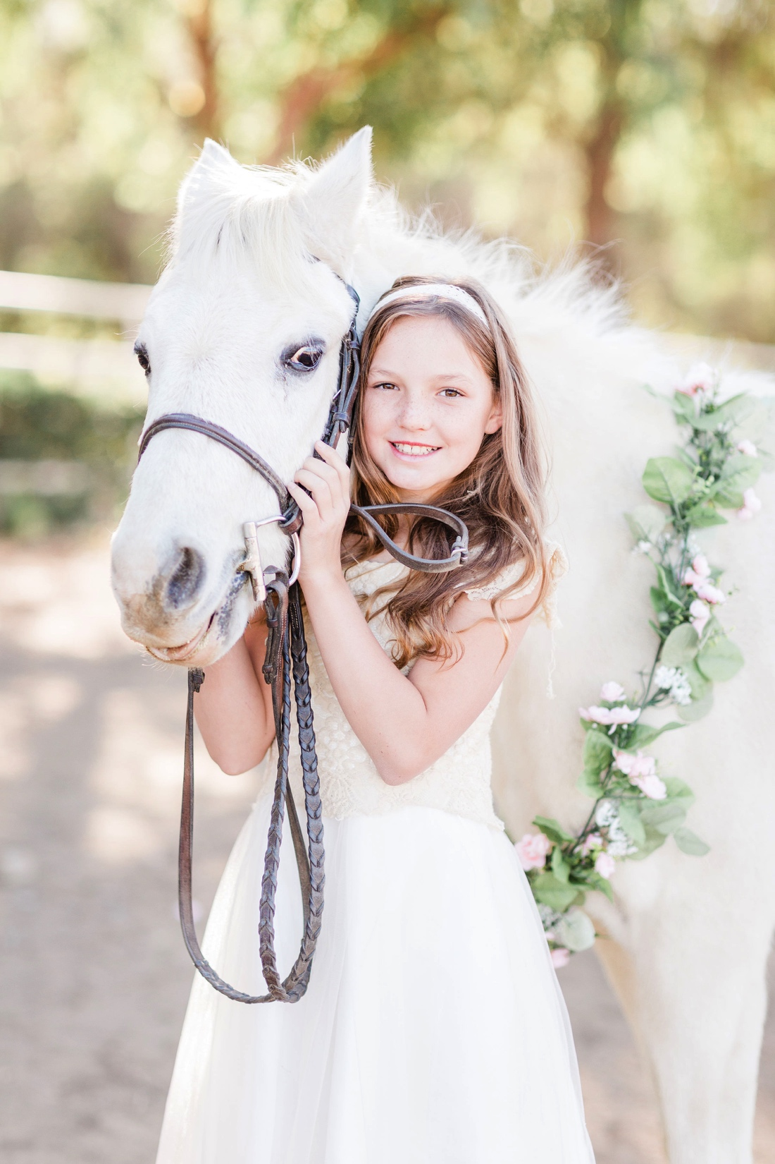
Grooming Horses
With Whitebrook Farm Pony Club Riding Center

Slide 2
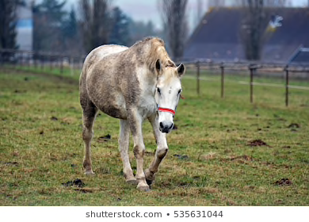
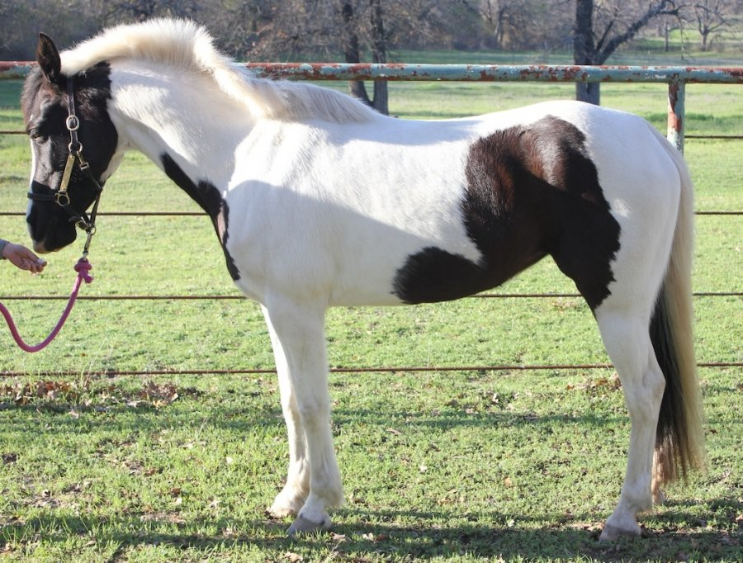
Grooming Your Pony
Reasons to Groom
To clean and make him look and feel nice
To check him over carefully for injuries and skin problems
To prevent sores from dirt under the tack when you ride him
To condition his skin and make his coat shine
To promote good circulation of the blood

Slide 3
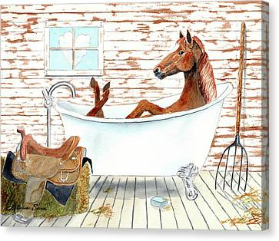
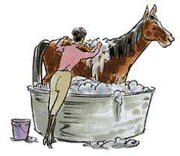
How often should a horse be groomed?
Your pony should be groomed or at least checked over every day, whether he is ridden or not. He must be cleaned before he is saddled to prevent dirt from causing saddle and girth sores. He should be brushed smooth after he has been ridden to remove sweat and any dirt, especially under the saddle and pad.

Slide 4
Steps in Grooming

Slide 5
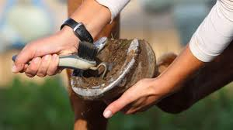
Step 1 Step 2
Pick out feet with a hoof pick
Use the rubber or plastic curry comb to rub the skin in circles starting at top of the neck and working your way down

Slide 6
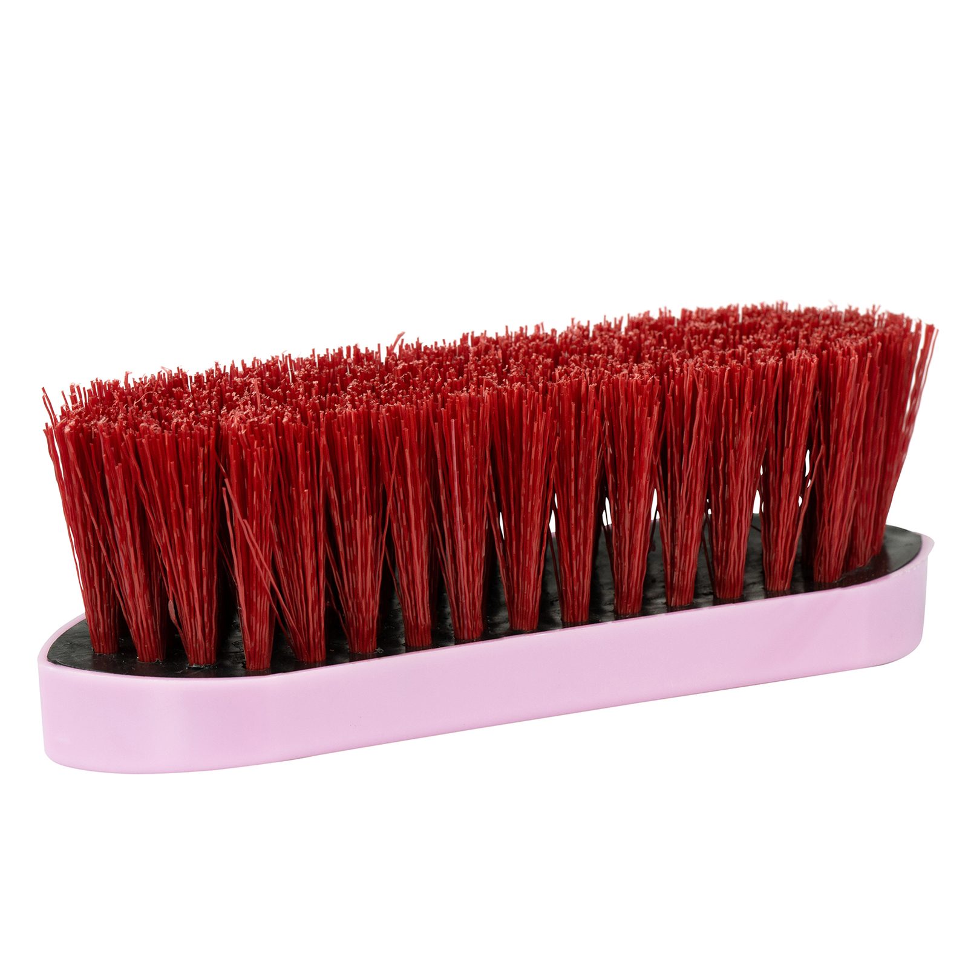
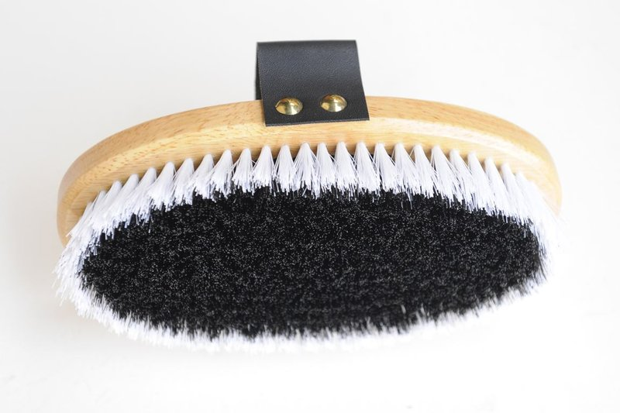
Step 3 Dandy Brush
Step 4 Body Brush
Use short firm strokes in the direction the hair grows to loosen dust
Start at the top of the neck and brush downward toward the back of the horse to loosen dirt and debris. Clean the brush every few strokes with metal curry comb.

Slide 7
Step 6
Brush the mane and tail
Manes: The way you groom and maintain the main depends on the discipline you ride. Some disciplines keep short manes by thinning/pulling the mane. Others maintain thick long manes.
Tails: Nobody wants a thin scraggly tail in any discipline! So never brush through a tail that has not been shampood, conditioned, and that does not have a detangling product.
Start at the bottom and work your way to the top slowly and carefully by patting the brush in and out of the hair until the tangles are gone and the brush can run through that portion of the hair.

Slide 8
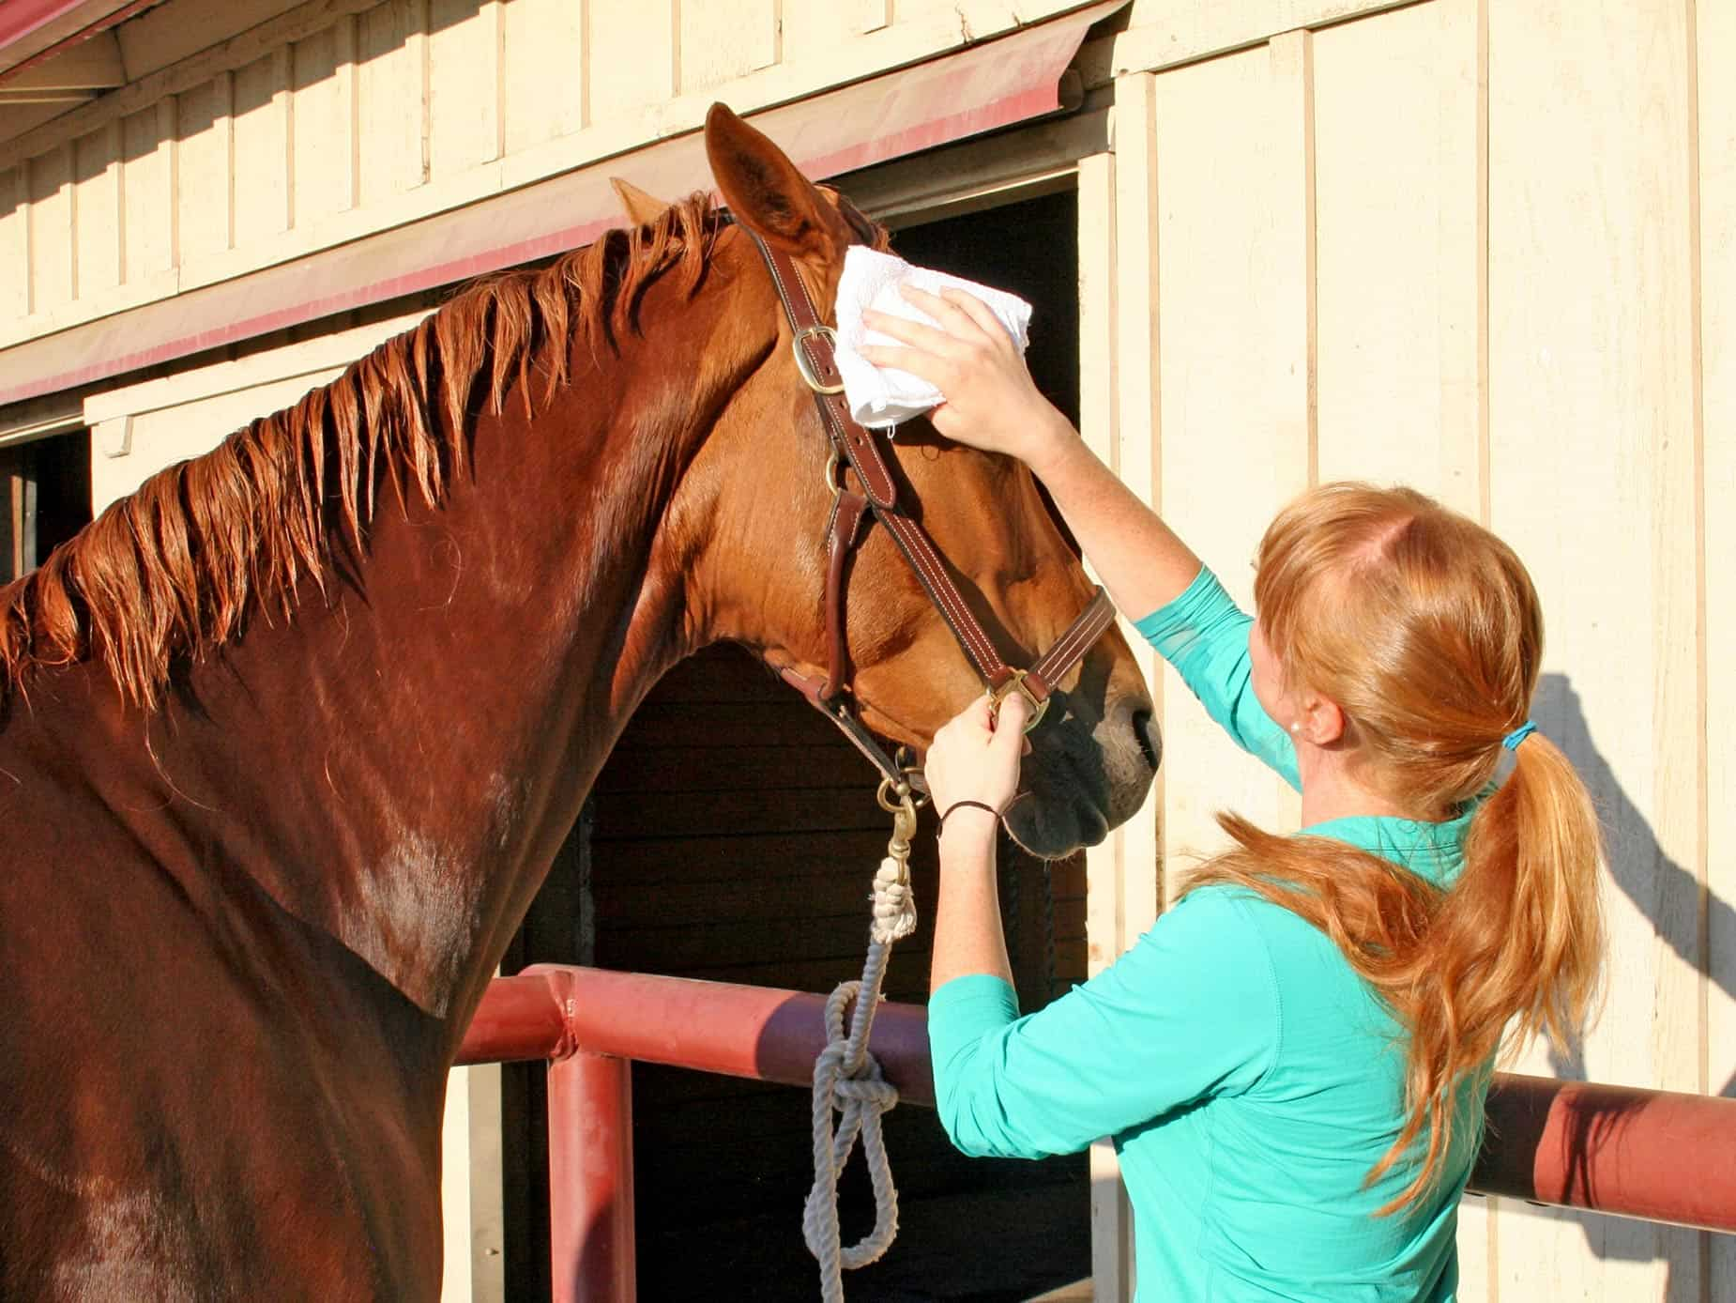
Step 7 Step 8
Rub a rag over the entire body to make it sleek and shiny
Use a damp sponge, rag, or unscented baby wipes to gently clean the eyes, nostrils, and muzzle. If the horse allows, you can also gently wipe the inside of the ear.
Use a separate sponge to clean the dock- underneath the tail- and the udder and sheath. But take care in these sensitive areas!

Slide 9
Step 9 step 10
If your pony still has manure or grass stains, use a damp towel, sponge, or cactus cloth
You may paint hoof dressing along the coronet band and heels of the horses feet

Slide 10
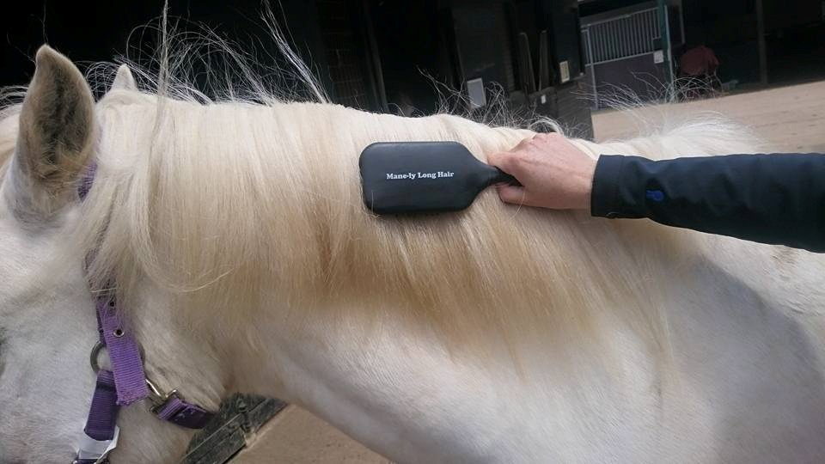
Step 10
For a final touch, wet your brush and dampen the roots of the mane. Brush it neatly over to the right side of the neck

Slide 11
What’s in my grooming kit?
What’s in My Grooming Kit Video

